Slide 1
Marketing Analytics Portfolio Project
Cameron Dace

Slide 2
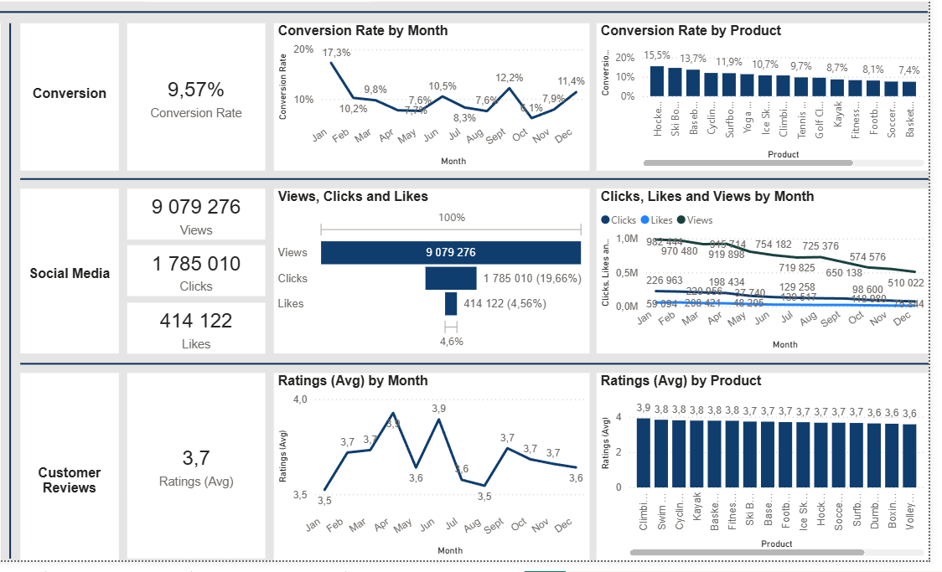
Overview
The conversion rate demonstrated a strong rebound in december, reaching 11.4%, despite a noticeable dip to 6.1% in October.
There is a decline in overall social media engagement, with view dropping throughout the year.
While clicks and likes are low compared to views, the click-through rate stands at 19.66%, meaning that engaged users are still interacting effectively.
Customer ratings have remained consistent, averaging around 3.7 throughout the year.
Although stable, the average rating is below the target of 4.0, suggesting a need to focus on improvements in customer satisfaction for products with a rating below 3.5.

Slide 3
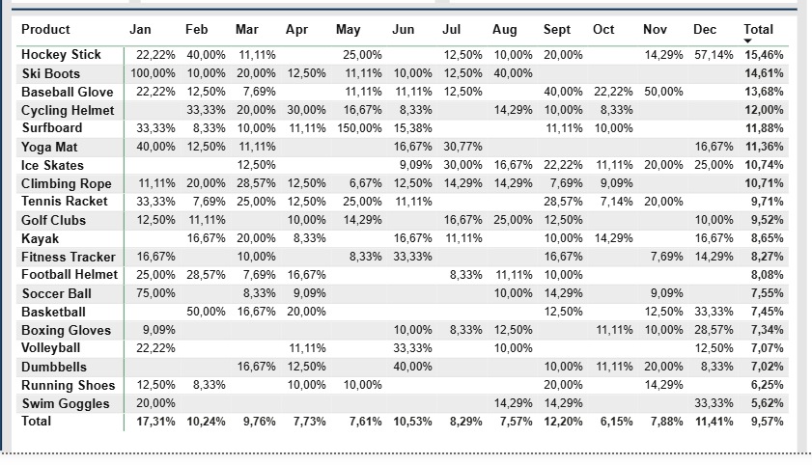
Decreased Conversion Rate
General Conversion Trend
  Throughout the year, conversion rates varied, with higher numbers of products converting in months like February and June. This suggests that while some products have strong seasonal peaks, there is potential to improve conversions in months gathering lower conversions with targeted interventions.
Lowest Conversion Months
  October experienced the lowest conversion rate of 6.15%, with no products standing out significantly in terms of conversion. This indicates a potential need to revisit marketing strategies or promotions during this period to boost performance.
Highest Conversion Rates
  January experienced the highest overall conversion rate of 17.31%, driven significantly by ski boots with a remarkable revenue of 100% conversion. This indicates a strong start to the year likely fueled by seasonal demand and effective strategies.

Slide 4
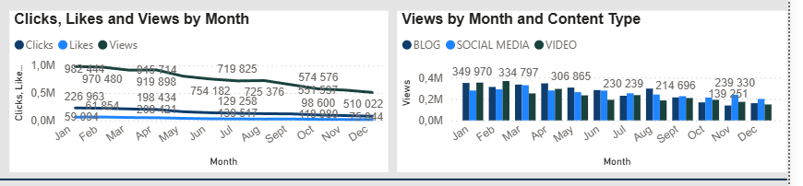
Reduced Customer Engagement
Declining Views
  Views peaked in January and April but declined there after indicating reduced audience engagement in the later half of the year.
Low Interaction Rates
  Clicks and likes remained consistently low compared to views suggesting the need for more engaging content or stronger calls to action.
Content Type Performance
  Blog content drove the most views, especially in April and January, while social media and video content maintained steady but slightly lower engagement

Slide 5
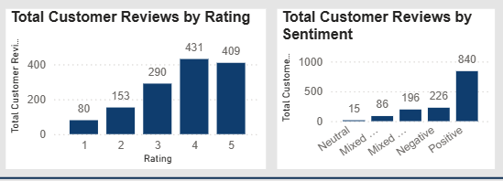
Customer Feedback Analysis
Customer Ratings Distribution
  The majority of customer reviews are in the higher rating with 409 reviews of 5 stars, indicating overall positive feedback. Lower ratings (1 - 2 stars) account for a smaller proportion, with 80 reviews of 1 star and 153 review of 2 star.
Sentiment Analysis
  Positive sentiment dominates 840 reviews, reflecting a generally satisfied customer base. Negative sentiment is presented in 226 reviews with a smaller number of mixed and neutral sentiments suggesting some areas for improvement but overall strong customer approval.
Opportunity for improvement
  The presence of mixed positive and mixed negative reviews suggest that these are opportunities to convert theses mixed experiences into more clearly positive ones, potentially boosting overall ratings. Addressing the more specific concerns in mixed review could elevate customer satisfaction.

Slide 6
Goals and Action
Goals
Increase Conversion Rates
  Goal: Identify factors impacting the conversion rate and provide recommendations to improve it.
  Insight: Highlight stages where visitors drop off and suggest improvements to optimize the conversion funnel.
Increase Conversion Rates
  Goal: Determine which types of content drive the highest engagement.
  Insight: Analyze interaction levels with different types of marketing content to inform better content strategies.
Increase Conversion Rates
  Goal: Understand common themes in customer reviews and provide actionable insights.
  Insight: Identify recurring positive and negative reviews to guide product and service improvements.
Actions
Increase Conversion Rates
  Target high performing product categories: Focus marketing efforts on products that are demonstrating high conversion rates such as Ski boats, Basketball Gloves and Kayaks. Implement seasonal promotions or personalized campaigns during peak months (such as January and December) to capitalize on these trends.
Enhance Customer Engagement
  Revitalize Content Strategy: to turn around declining views and low interaction rates, experiment with more engaging formats such as interactive videos or user-generated content. Additionally boost engagement by optimizing call-to-action placements in social media and blog content, particularly in lower engagement months (Decemebr and October)
Improve Customer Feedback Score
  Address Mixed and Negative Feedback: Implement a feedback loop where mixed and negative reviews are analyzed to identify common issues. Develop improvement plans to address these concerns. Consider following up with dissatisfied customers to resolve issues and encourage re-rating, aiming to more average ratings to the 4.0 target.

